Slide 1


M.Tech Dissertation
Data Science and Engineering
Dissertation title:
Road accident Detection and notification, Prediction and Prevention
Dissertation Done at :
Vodafone Idea Ltd (Vi)
Under the Supervision of :
Soumen Das (Vi)
Under the Guidance by:
Maninder Singh Bawa (BITS Pilani)
Dissertation done By :
Suraj P B
2018AB04032

Slide 2
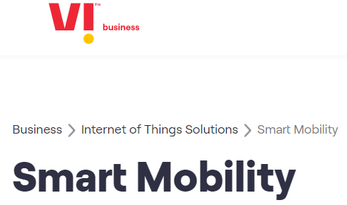
Why this Project ?
According to the World Health Organization, more than a million people in the world die each year because of transportation-related accidents. The risk of accident or crash on road has become an unavoidable issue globally and of everyone’s concern. WHO have predicted the figure would reach 2 million casualties by the year 2022 if no action is taken.
Benefits to the Organization :
https://www.myvi.in/business/enterprise-solutions/internet-of-things-solutions/smart-mobility
Vi™ IoT has a number of products and services addressing the complete Internet of Things (IoT) market – connecting machines, devices and services. Among which I am planning to expand a prototype to our organization to the project called Smart Mobility, which is in initial stage now. Vi Smart Mobility uses an IoT- enabled ‘black box’ to make your vehicle a ‘connected vehicle’.

Slide 3
Main Objectives of Proposed system
To create a prototype of this system our objectives include
1. To identify the road crash and to inform the incident to rescue team – Detection.
2. To identify whether the vehicle was moving over speed
3. To predict the road accidents by analyzing the historical dataset through machine learning approach
4. To identify a snoozing driver through deep learning way
5. To build a big data stream processing model for such N number of vehicles and X no. of sensors outfitted with it
6. To architect a Big data platform by forecasting the future demand if we commercialize this product in a wide scale

Slide 4
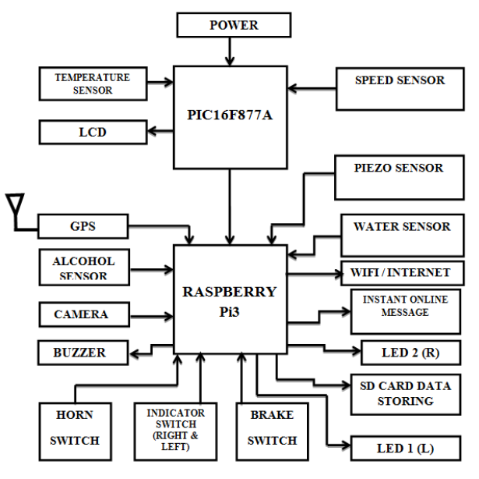
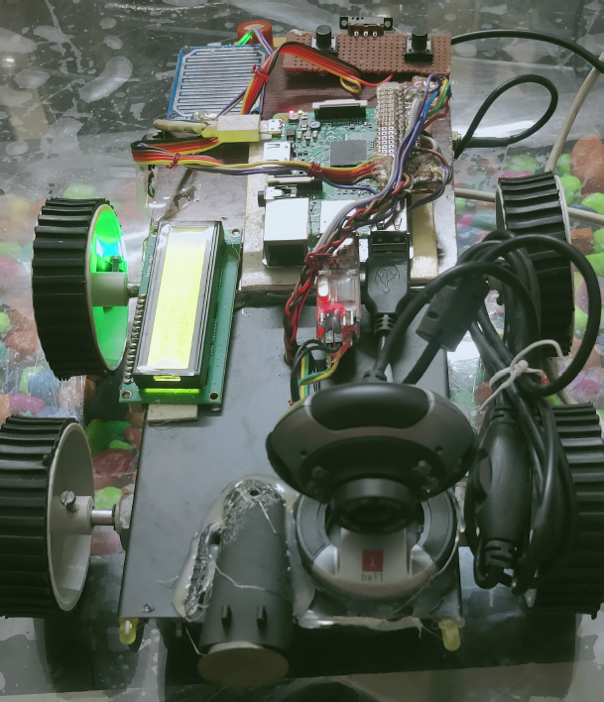
Accident Detection and Notification through Edge hardware system
GPIO operations of Raspberry Pi
Sensor IO and interfacing
Email and Message notification
Edge Hardware python code review
Edge Hardware Demo

Slide 5
Accident Prevention through Deep learning way
Drowsiness detection and alerting the Driver to prevent the accidents
A camera in front of the driver face which detects the driver’s face and using deep learning identify the driver eyes closed or opened with the help of this data system detect driver drowsiness.
Neural network architecture
CNN model building as per Neural network architecture and the training the model
Performance analysis of the model
Code Review
Real time face detection - Demo

Slide 6
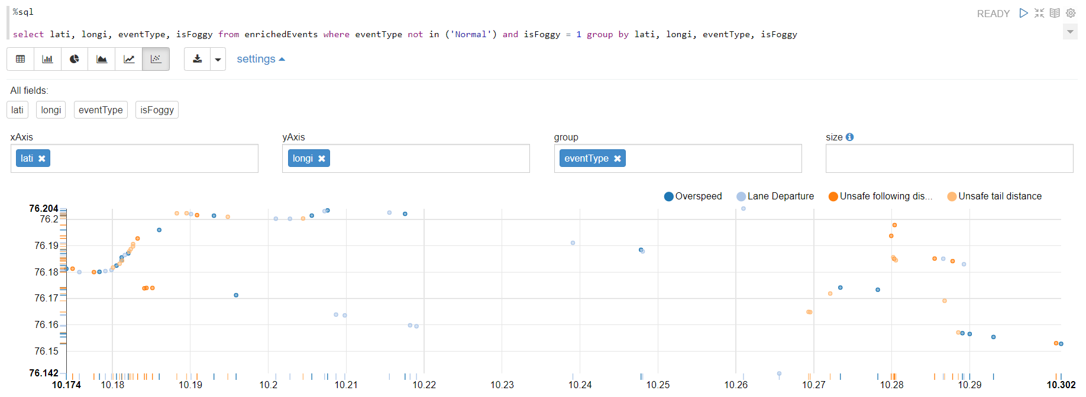
Accident Prediction using Apache Spark – Data at rest
Machine Learning and Exploratory data analysis using Apache Zeppelin
exploratory data analysis (EDA)
SQL Queries against the RDD such as
1. Do certified Drivers have less violations?
2. What’s impact of fog/rain/wind on driving?
3. Does location has any impact on Incident?
Insertion of dataset into HDFS
Creation of RDD
Enrich the events and SQL on hadoop
EDA – Demo
Regression model building
Machine Learning Demo

Slide 7
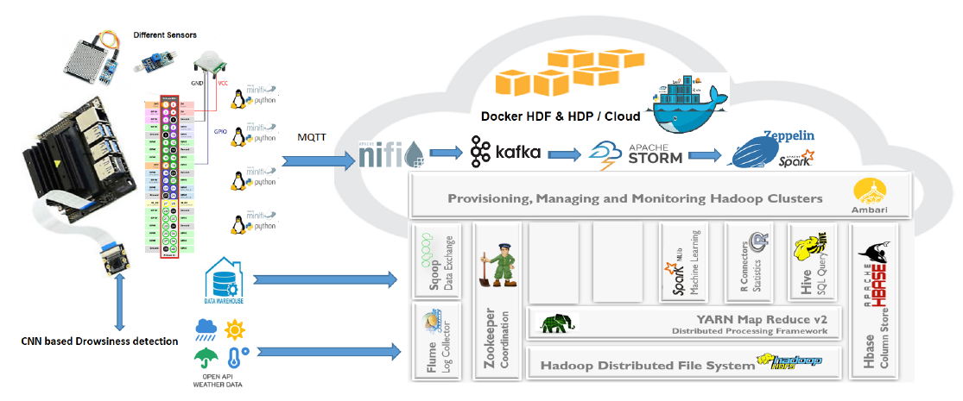
Stream Processing Analytics and Big data modelling
Start Nifi cluster and configurations – Nifi bundle – NAR and event viewers : Nifi Method
Data Simulator – Development in Scala – Why scala – Code Method.
Run and deployment of Scala code – Demo : Run the Simulator script
Kafka Producer – Consumer – Listing the topics
/usr/hdf/current/kafka-broker/bin/kafka-topics.sh --list --zookeeper localhost:2181

Slide 8
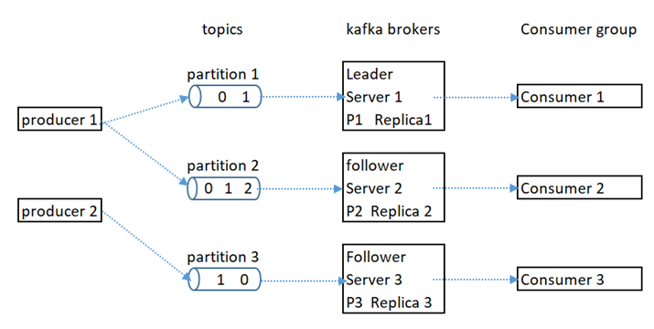
5. View Data in Kafka Topics in Encoded Avro format
View Data for Kafka Topic: trucking_data_truck_enriched:
/usr/hdf/current/kafka-broker/bin/kafka-console-consumer.sh --bootstrap-server sandbox-hdf.hortonworks.com:6667 --topic trucking_data_truck_enriched --from-beginning
View Data for Kafka Topic: trucking_data_traffic:
/usr/hdf/current/kafka-broker/bin/kafka-console-consumer.sh --bootstrap-server sandbox-hdf.hortonworks.com:6667 --topic trucking_data_traffic --from-beginning
Creation Commands : ( Not required – Already done)
/usr/hdf/current/kafka-broker/bin/kafka-topics.sh --create --zookeeper sandbox-hdf.hortonworks.com:2181 --replication-factor 3 --partitions 3 --topic trucking_data_truck_enriched
/usr/hdf/current/kafka-broker/bin/kafka-topics.sh --create --zookeeper sandbox-hdf.hortonworks.com:2181 --replication-factor 3 --partitions 3--topic trucking_data_traffic

Slide 9
6. Storm topology Demo
Topology: A network of spouts and bolts that are connected together by streams.
In other words, the overall process for Storm to perform.
Vehicle Data model : EnrichTruckdata : Sample
1510767711734|26|1|Suraj PB|107|Kerala to Bangalore|17.95940879245423|10.21923828125|65|Speeding|1|0|1|60
TrafficData :
1508767711734|107|60
WindowedDriverStats :
1|67|3|2|3|2
Compare with schema at :
schema-registrar → src → main → resources → schema
stormtopology --> reference.conf (Topology settings)
Outputs : WindowedDriverStats and EnrichTruckandTrafficData back to Kafka for Viewing in the Web app

Slide 10
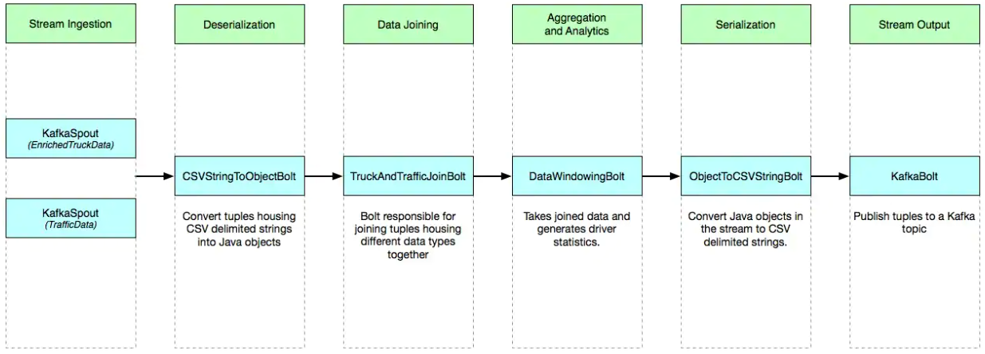
7. Storm Spouts and Bolts – Code review
Spouts:
- KafkaSpout (for injesting TruckData)
- KafkaSpout (for injesting TrafficData)
Bolt:
- CSVStringToObjectBolt (for creating JVM objects from strings)
- TruckAndTrafficJoinBolt (for joining two datatypes into one)
- DataWindowingBolt (for reducing lists of tuples into models for machine learning)
- ObjectToCSVStringBolt (for serializing JVM objects into strings)
- KafkaBolt (for pushing strings into Kafka topics)

Slide 11
We will package this project up into a portable JAR file and run a quick command that will deploy this code onto a storm cluster.
Demo : Run the script : rebuild-and-deploy-topology.sh
Under the hood runs following jar
storm jar trucking-iot-demo-storm-on-scala/target/scala-2.12/trucking-iot-demo-storm-on-scala-assembly-1.1.0.jar com.orendainx.trucking.storm.topologies.KafkaToKafka
JAR file demo.
storm will submit the jar to the cluster. After uploading the jar, storm calls the main function of the class we specified (com.orendainx.trucking.storm.topologies.KafkaToKafka), which deploys the topology by way of the StormSubmitter class.

Slide 12
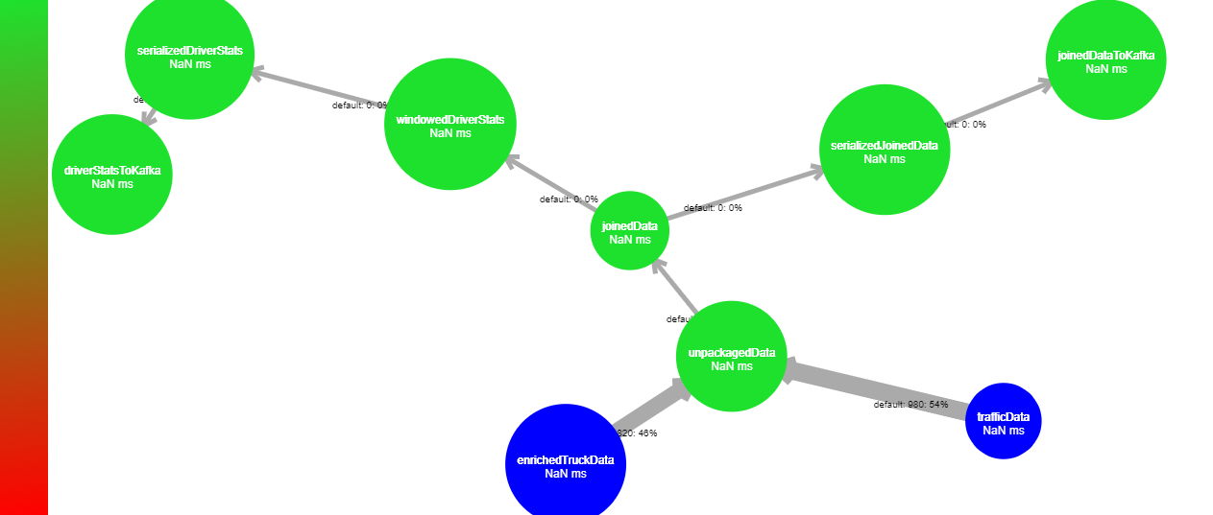
Storm Topology

Slide 13
Architect Big data Solution for Vi
Analyze our model : How big will be vehicle IoT data?
Suppose if we have installed IoT edge device in 5000 vehicles, if each sensor events to company data center is 10, then per second 50000 events should get processed in real time (DB hits, Continuously train and fine-tune the ML model).
Suppose size of each event is 128bytes then for one Year = 5000*10*128*60*60*24*365 = 200TB
and for 5 years it might become 1.5PB
Hbase storage needed ?
No. of Worker Nodes ?
Nifi, Kafka , Storm nodes needed ?
Hbase nodes needed ?

Slide 14
